Slide 1


ImpactMapper x DataRes
API

Slide 2


Project Goal
Value-based investing using information from articles written
globally about companies on crucial topics such as human rights, climate change, and racial equality.

Slide 3

Project Breakdown
Sentiment Analysis
GNews API Replacement &
News Importer Migration
2,681
ARTICLES
Classification
by Key Terms

Slide 4
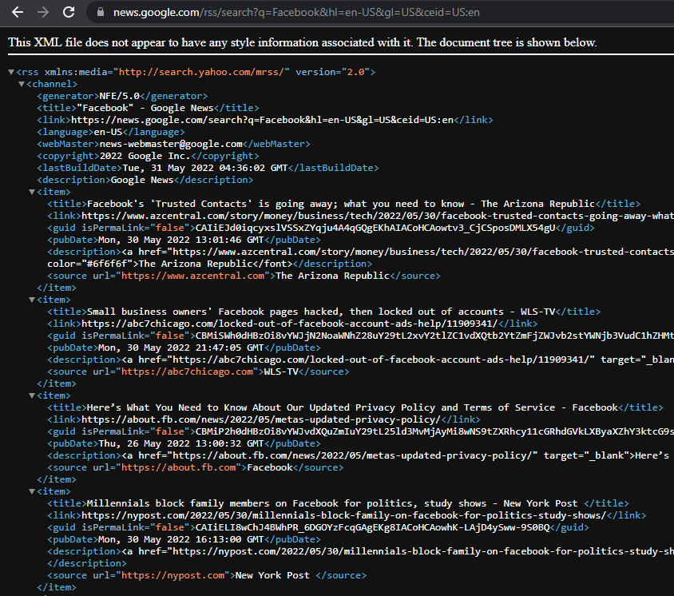

API Replacement and News Importer
Replacement for Google News API — directly searching Google News itself.
Harvest news articles through parsing of an RSS representation
Interpet news articles through third party library “News Please”
Integrate new manual scraping replacement into existing application
Store news article features into existing Django object models

Slide 5
API Replacement and News Importer
Other potential options (for Tweets too!):
API Replacement Sheet

Slide 6
Classification by Key Terms
Meet The 2021 Women In Film Pathmakers
WIF’s latest program was curated specifically for both aspiring and veteran Black women in the film industry
Women Leaders | ✔️
Racial Equality | ✔️
Women on Boards | ❔
Gender Equality | ❔
Black Lives Matter | ❔
Climate Change | ❌
…… | …

Slide 7
Targeted Sentiment Analysis
target
sentiment: negative
“Amazon faces mounting scrutiny over worker rights while
Coca-Cola has agreed to increase wages for all workers…”
target
sentiment: positive

Slide 8
Thank you!

